Slide 1

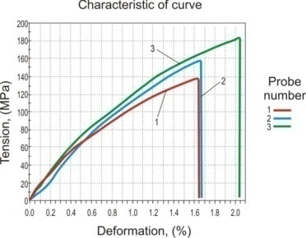
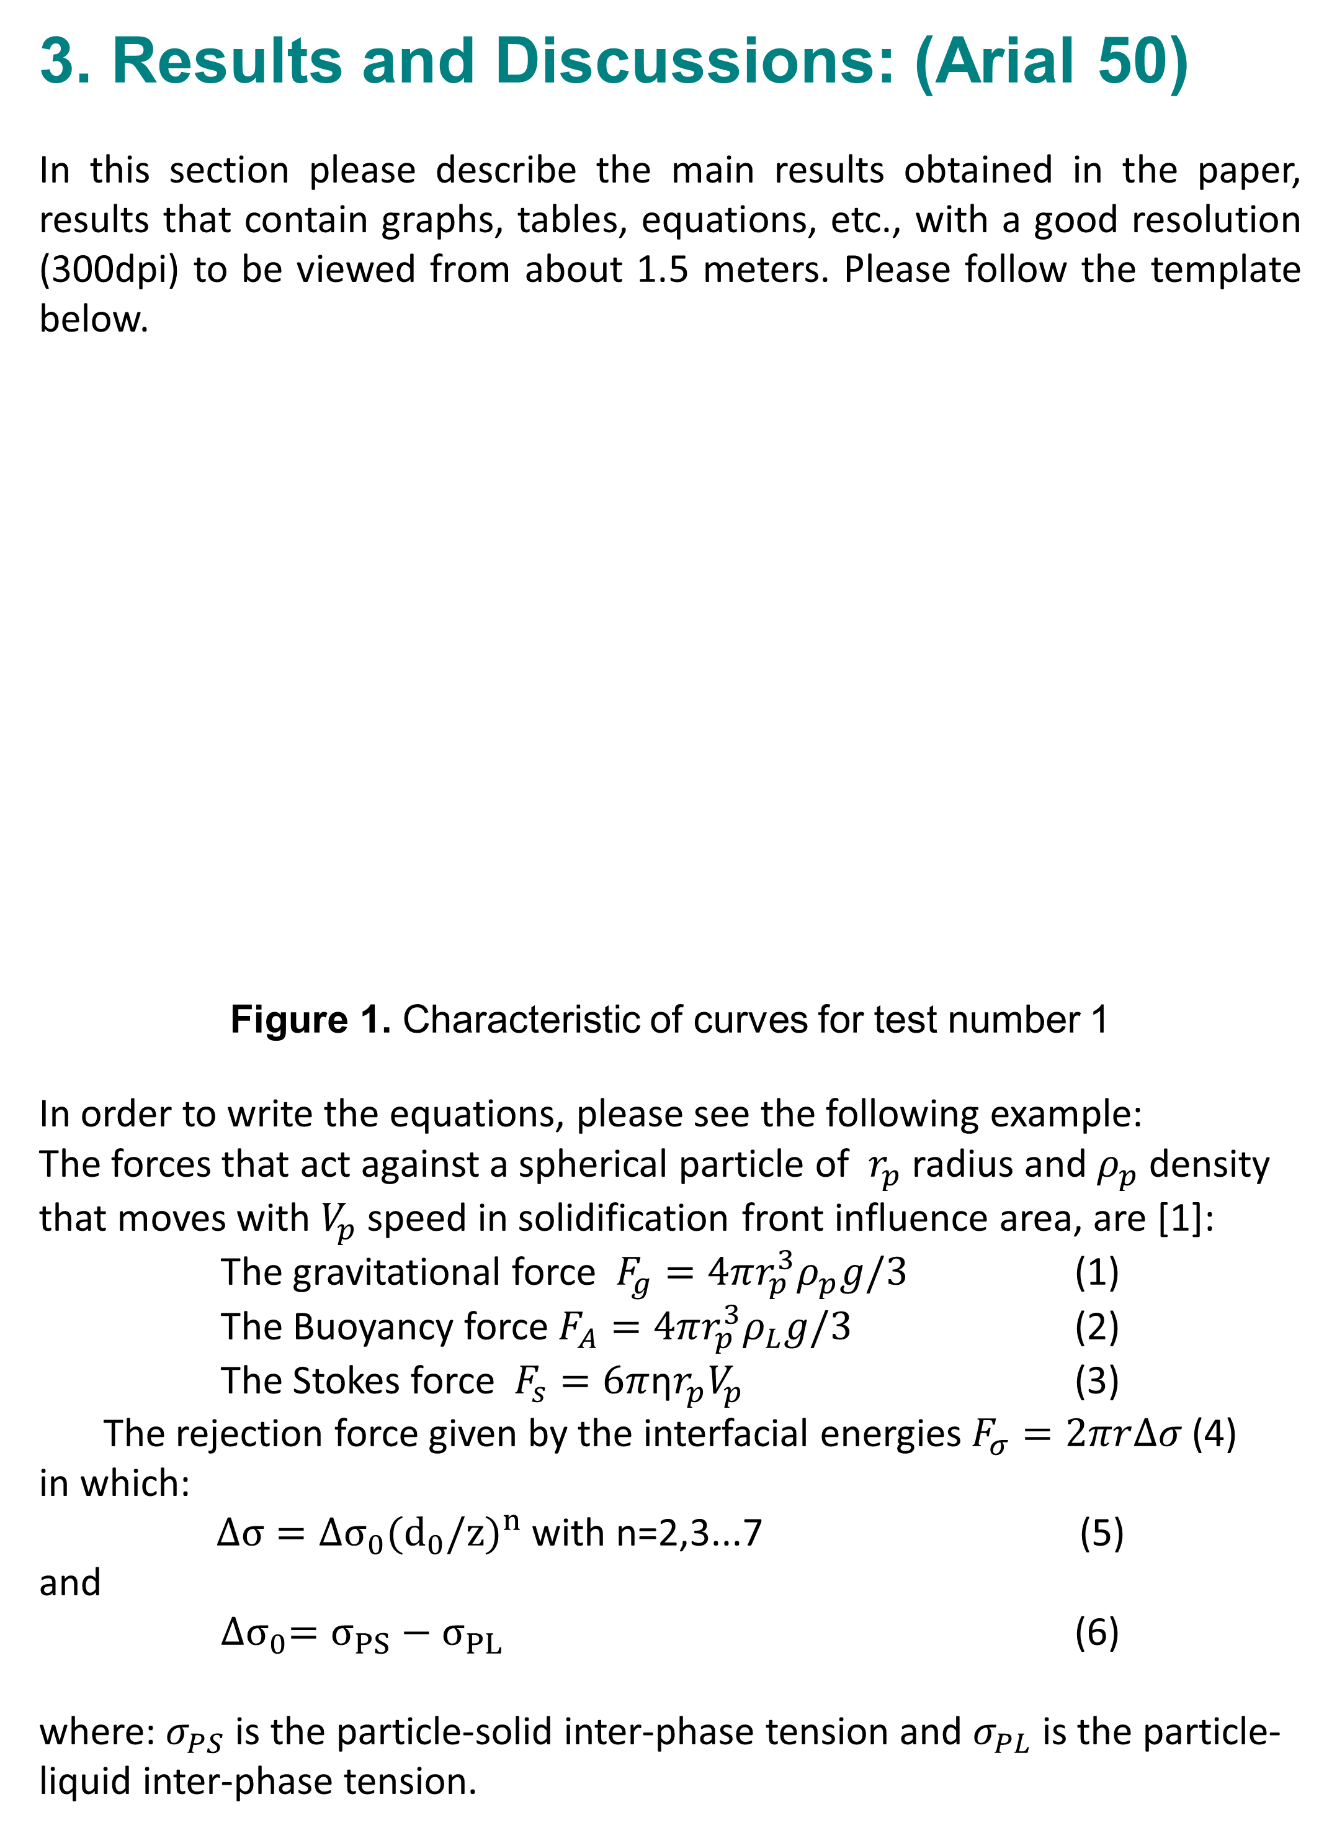
Paper Title
(Center, Arial (Bold) 80)
Authors & Affiliation Including Email (Arial 60)
June 04-05, 2020,
Iasi, Romania
Your Institution Logo,
Name and Country
Keywords: (Arial 50)
Please provide the same list of 4-5 keywords as in the final article that will be sent for reviewing before publication. (Arial 30)
Table 1. The chemical composition of the alloys used
The results shown and related comments should be compared with the results in literature, while highlighting the novelty of the research, as well as the advantages or possible directions for further research.
All the figures, tables and equations should be explained and if some of them are from literature please indicate their bibliographical sources.
Type of alloy | Chemical composition, in mass [%]
 | Mg | Cu | Si | Fe | Mn | Al
ENACAlSi5Cu3Mg | 0.22 | 3.46 | 4.80 | 0.40 | 0.24 | Rest
ENACAlSi7Cu2Mg | 0.59 | 2.31 | 7.30 | 0.41 | 0.22 | Rest
AlMgSi0.5 | 0.49 | 0.04 | 0.33 | 0.20 | 0.05 | Rest
1. Introduction: (Arial 50)
In the poster introduction please provide a short description of the current state of national and international research in the field tackled by your paper. The introduction should point out why the research tackled in your paper is necessity to the field.
Please do not include the paper abstract in this part of the poster.
The poster must be written in English respecting the template settings shown.
Please make sure that the paper submitted is original and the publisher’s requirements are met. The figures, tables and equations in the poster must be clear and their wording must respect the example rules.
2. Experimental Part: (Arial 50)
In this part of the poster please present briefly the experimental research method(s) used.
You may include the equations, tables and graphs which are part of the research methodology chosen.
It is also advisable to point out the advantages of the method used as opposed to the disadvantages of the other experimental research methods.
This section should also include the materials used and the production or processing technologies employed. If the paper deals with the development of materials / technologies please provide the main characteristics obtained.
4. Conclusions: (Arial 50)
The conclusions should be clear, they should refer exclusively to the results obtained against those that already exist in literature.
It is advisable that the ideas summarized in the conclusion be related and that their mere presentation as a sequence of ideas be avoided.
Also, the conclusions should not include figures, tables and equations.
The final conclusions part should refer to possible future research suggested by the author / authors.
The Organizing Committee of the ModTech International Conference indexed by ISI Web of Science thanks all the authors / participants for their confidence and support for the improvement of the quality and visibility of our conference.
Many thanks to our Keynote Speakers/Invited Speakers for their lectures of the highest scientific level, which brought an undeniable added value to our ModTech International Conference.
Last but not least, the executive board of the ModTech Professional Association thanks all our sponsors for their financial / material support of our last four editions of the ModTech conference.
3. Results and Discussions: (Arial 50)
In this section please describe the main results obtained in the paper, results that contain graphs, tables, equations, etc., with a good resolution (300dpi) to be viewed from about 1.5 meters. Please follow the template below.
Figure 1. Characteristic of curves for test number 1
In order to write the equations, please see the following example:
The forces that act against a spherical particle of $r_{p}$ radius and $ρ_{p}$ density that moves with $V_{p}$ speed in solidification front influence area, are [1]:
The gravitational force $F_{g}=4πr_{p}^{3}ρ_{p}g/3$ (1)
The Buoyancy force $F_{A}=4πr_{p}^{3}ρ_{L}g/3$ (2)
The Stokes force $F_{s}=6π$η$r_{p}V_{p}$ (3)
The rejection force given by the interfacial energies $F_{σ}=2πr∆σ$(4)
in which:
$∆σ=∆σ_{0}({d_{0}/z)}^{n}$ with n=2,3...7 (5)
and
${∆σ}_{0}=σ_{PS}−σ_{PL}$ (6)
where: $σ_{PS}$ is the particle-solid inter-phase tension and $σ_{PL}$ is the particle-liquid inter-phase tension.
5. Acknowledgments: (Arial 50)
Please specify here the funding sources that made your experimental research possible, whether they are national or international research projects, or they are sponsorship or research contracts signed with different companies.
Thanks may also be addressed to those who were involved in the drafting of the papers but for various reasons are not their authors.
References: (Arial 50)
[1] Carcea, I., Agop, M., (1995), Transition and Equilibrium Processes in Metal-Ceramic Particles Systems, Metallurgical Transactions, Vol. 26ª, pp.23-29.
[2] Gomez, L.S., et al. (2009), Nanostructured Y2O3 particles doped with europium, International Journal of Modern Manufacturing Technologies, Vol.I, No. 1, pp. 43-49.
[3] Rohatgi, P.K., Asthana, R., (1998), Transfer of Particles and Fibers from Gas to Liquid During Solidification Processing Composites, in Cast Reinforced Metal Composites, edited by S.G. Fishman, A.K. Dhingra, World Materials Congress, Chicago, pp. 61-67.
[4] http://www.engr.sjsu.edu/MC2/SOP_EDAX.pdf, [Accessed 20.01.2012].
[5] Wang Z, Liang P, Guan Y, Liu Y & Jiang L, Indian J Eng Mater Sci, 21(2) (2014) 121-127.

